Slide 1
CMPE-280 WEB UI DESIGN
Auction Based Marketplace For Students
TEAM PROJECT
Team Members
Rohit Kotecha - 016421405
Kusuma Padma Kavya Bandi – 016021785
Vishwa Tejendra Pernapati - 016701009
Sudheendra Katikar - 015948465

Slide 2
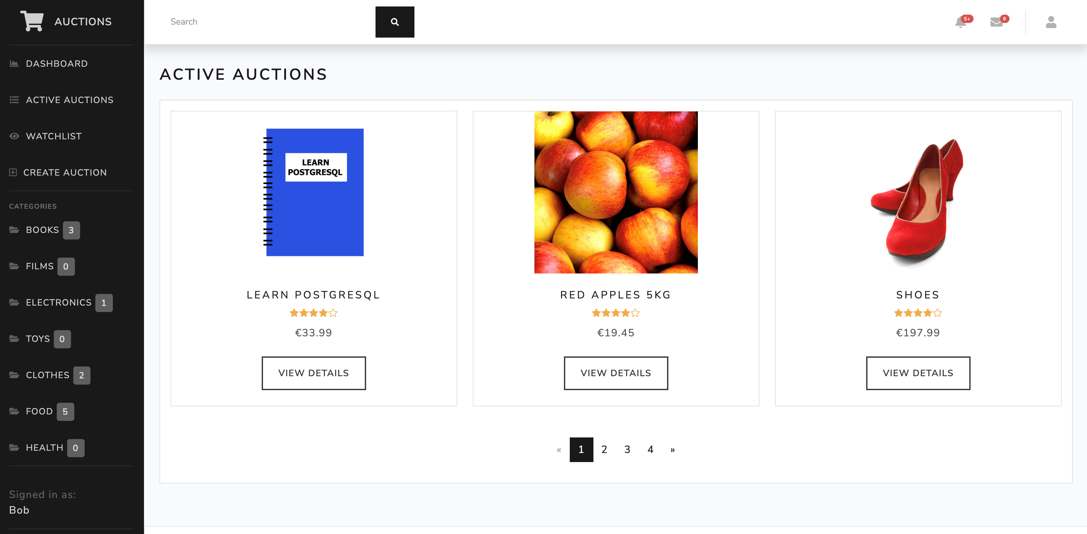
INTRODUCTION
Django
Postgres DB
SQL database to store data.

Slide 3

KEY POINTS
This e-commerce auction website allows users :
To create new auctions
Place bids
Comment on existing auctions
Add to a watchlist auctions they are interested in and want to keep an eye on.

Slide 4
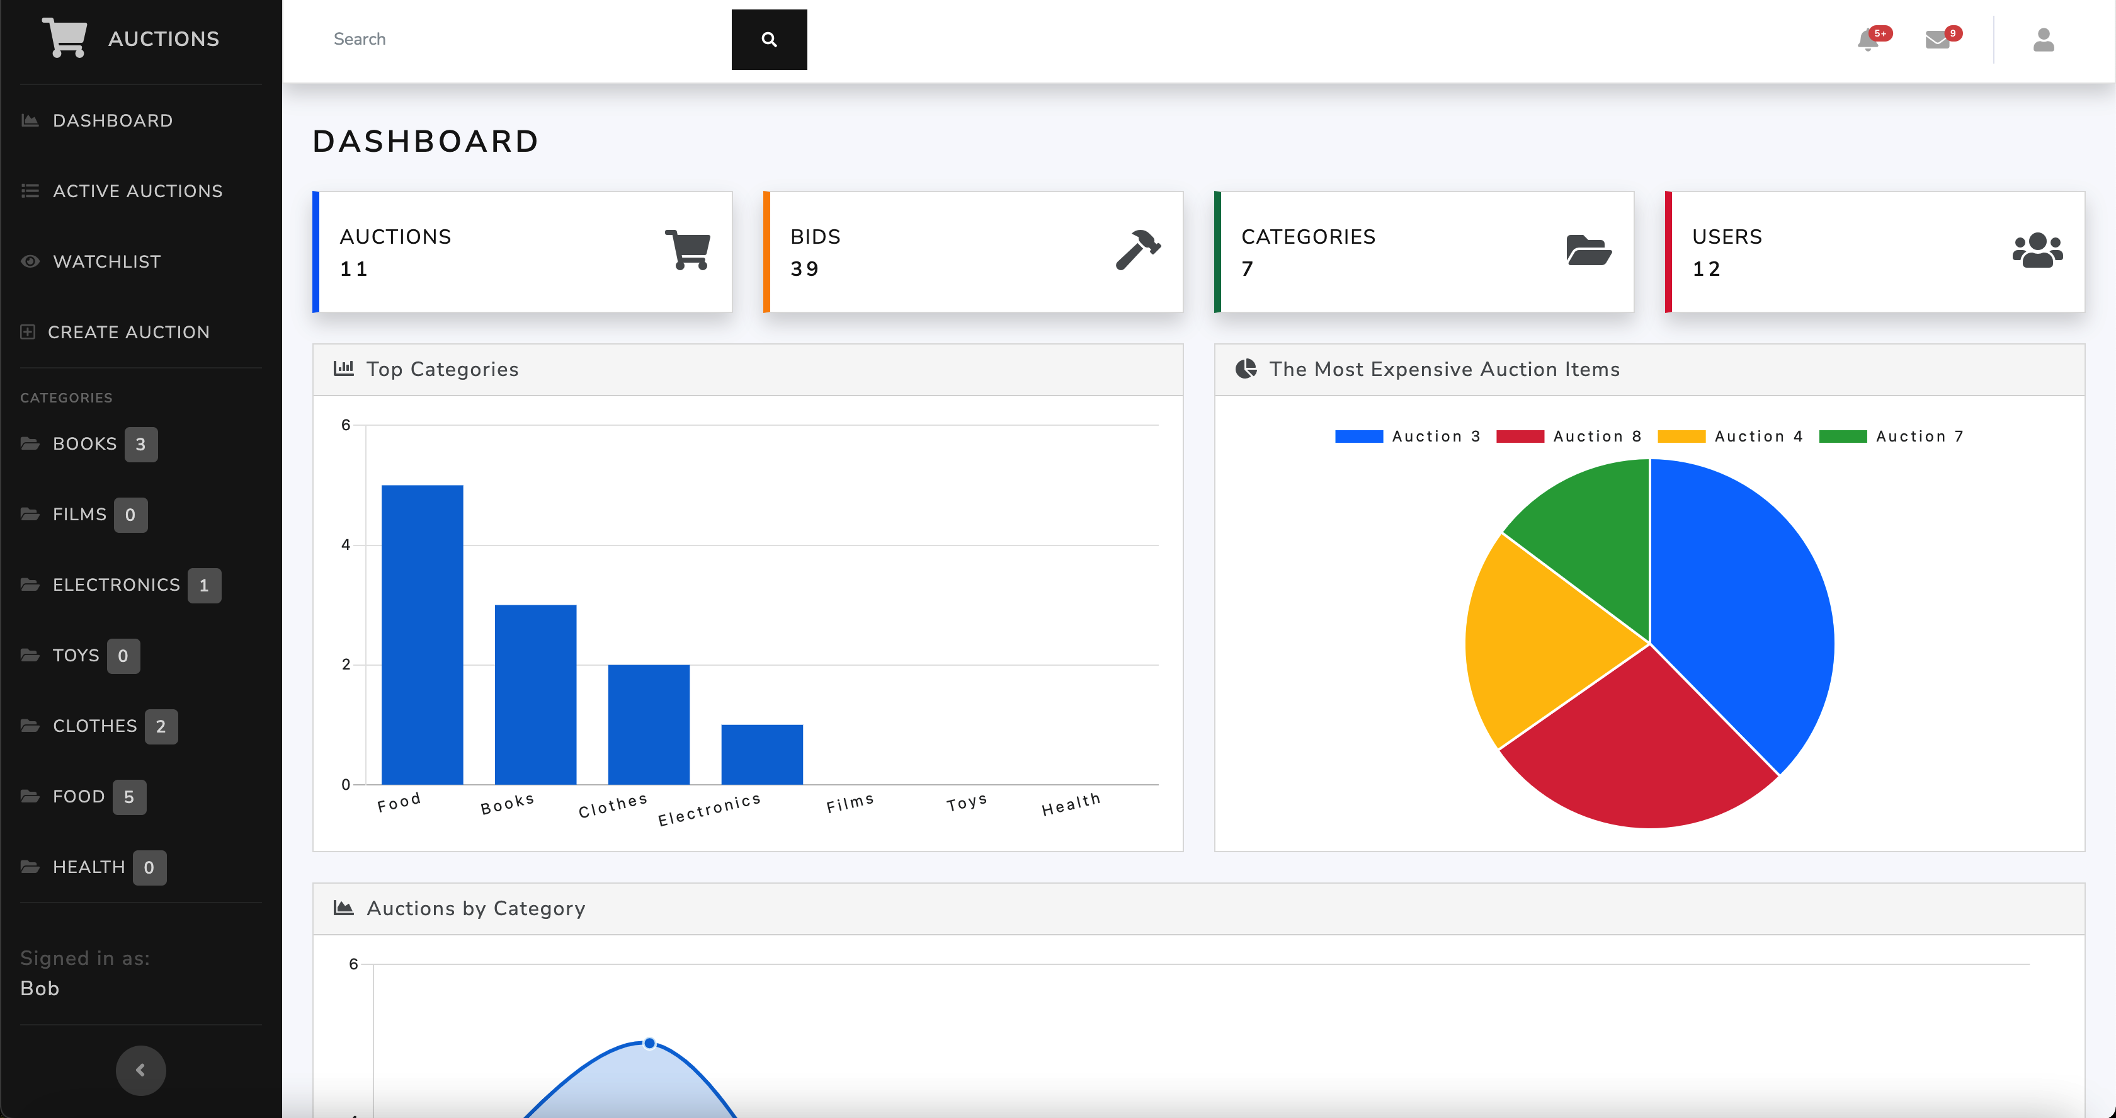
DASHBOARDS
We have also created some charts using the chart.JS Library. We tried to present 3 different charts in this project.
1. Bar chart
2. Pie chart
3. Area chart

Slide 5

HOW DOES THIS APLICATION WORK?
When we go to the website, we first present with a dashboard page.
Here, we can find the graphics summary of the data and trends in the application.
At the top, we can find the data summary that is: 1. The number of auctions that are currently available in the system. 2. The number of product categories. 3. The number of bids placed by buyers on the existing auctions. 4. The number of all users in the application - Both buyers and sellers.
We can also view all active auctions by categories sorted via navigation pane on the left hand side.
The other parts of the application are available only to the registered users who have created an account in the system.
Once we’re logged into the application, we can view the details of each of the active auctions available in the system.

Slide 6

INSTALLATION
Python 3.9.12 or higher
PostgreSQL
Visual Studio Code
Creating and activating virtual env.
Install required dependencies
Set up a PostgreSQL database
Set up environment variables
Run migrations
Create an admin user to access the Django Admin interface
Run the application
Add data to the application

Slide 7
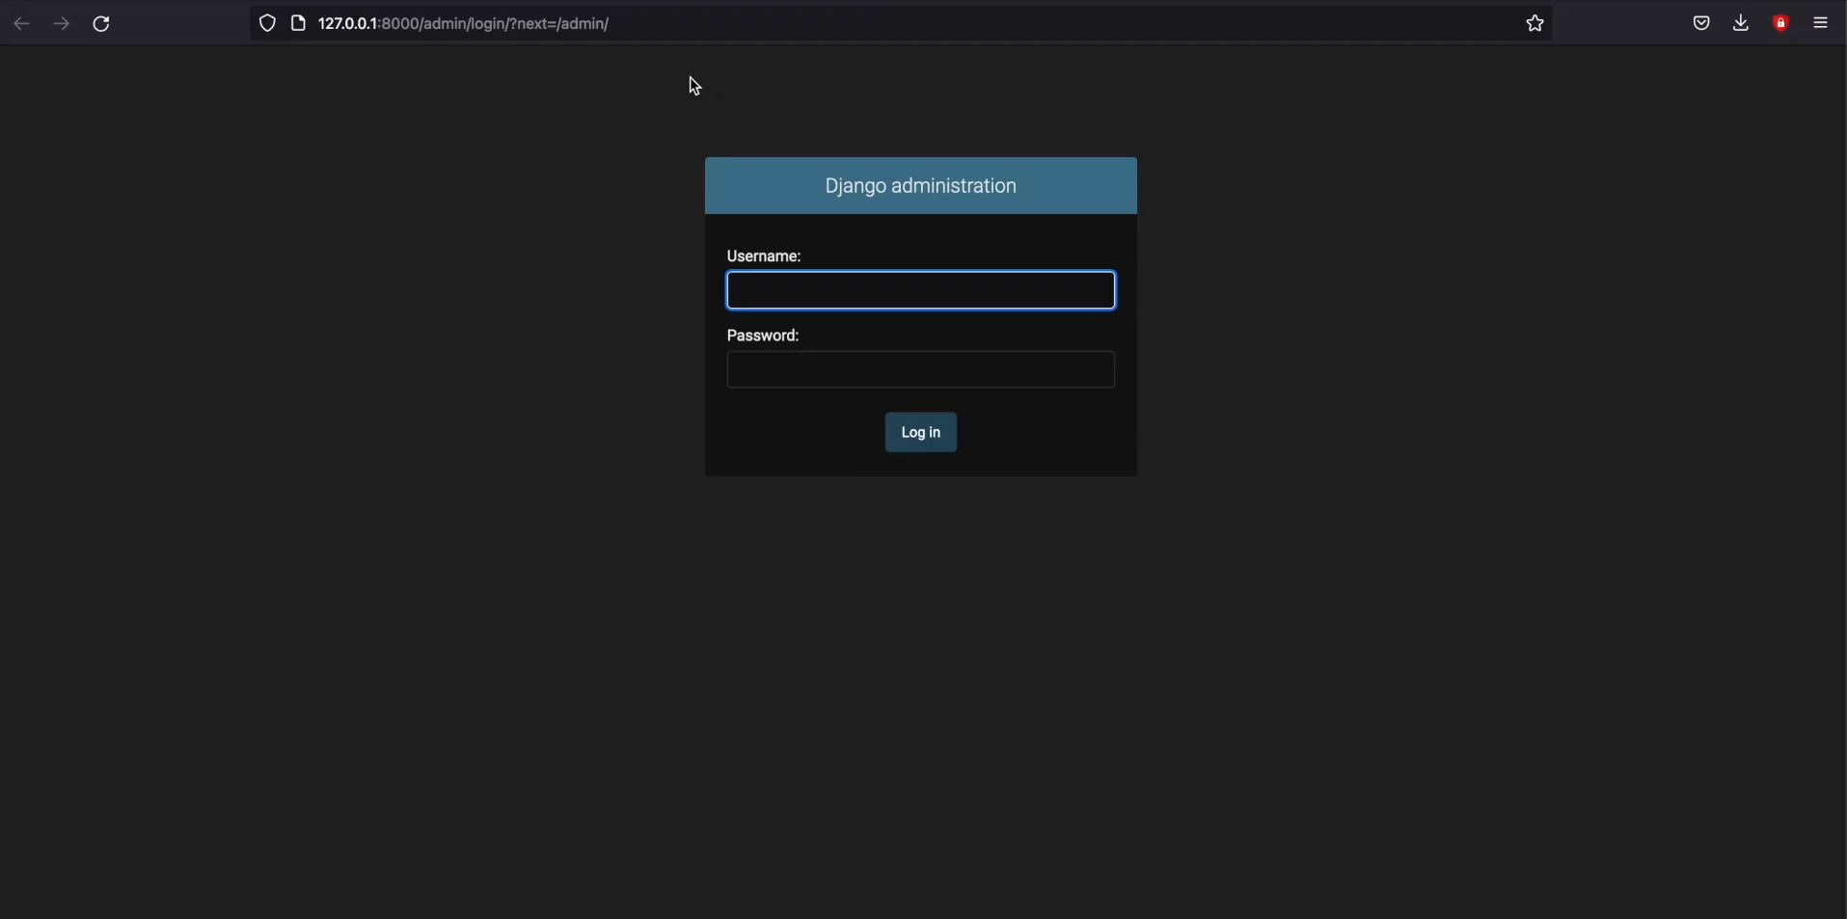
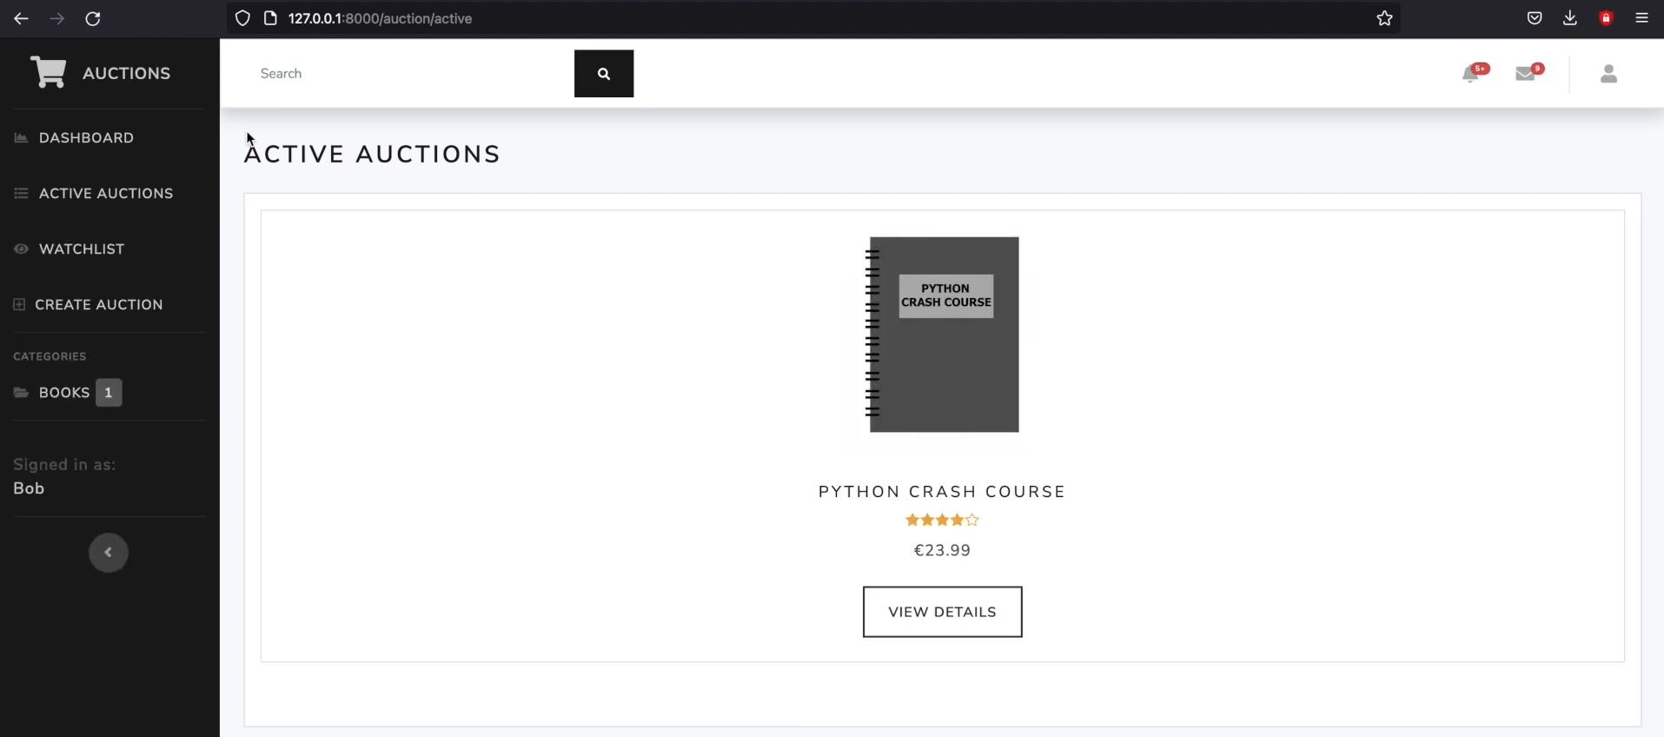
ADDING DATA VIA Django ADMIN
Go to http://127.0.0.1:8000/admin to access the Django Admin interface and sign in using the admin credentials.
Go to options link and click “ADD Auction”
Enter the necessary data that is required and save the auction.
The item can be seen under “Active Auctions” category to all the users.

Slide 8

THANK YOU

